Slide 1

MAIN TITLE SLIDE GREY
Notes:
Introduction: Traci
In this webinar, you’ll learn:
How recent industry trends gathered in our 2021 Video Streaming Latency Report informed the development of this new feature.
How to reliably deliver sub-500ms live interactive streaming globally with Wowza Streaming Cloud.
How to scale up to a million viewers with on-demand availability, and the recommended workflows for achieving this.
How to deliver assurance that your audience will have a smooth experience from the moment they join your stream.

Slide 2
Agenda
Brief Overview and Speaker Introductions
2021 Video Streaming Latency Report Findings
Real-Time Streaming at Scale Launch Overview
Features and Benefits
Capabilities
Real-Time Streaming at Scale Workflow
Real-Time Streaming at Scale Demo
Current Use Cases
Streaming Live on Social:
~45 minutes of presentation
Q&A throughout
Questions -> Input into Q&A Window
Notes:
Panelist: Traci

Slide 3



Panelists
Traci Ruether (Moderator)
Content Marketing Manager
Barry Owen
VP of Solutions Engineering
Tim Dougherty
Director of Sales Engineering
Robert Vacante
Principal Product Manager
Notes:
Panelist: Traci
Justin: <<Insert Poll Question>>
What is your audience size?
1 – 10
11 – 50
51 – 300
300+
How much latency are you currently experiencing? · Sub-45 Seconds · Sub-10 Seconds · Sub-3 Seconds · Sub-1 Second

Slide 4

2021 Video Streaming Latency Report Findings
This report gathers data from more than 200 broadcasters across the globe, in industries ranging from media and entertainment to fitness, surveillance, and everything in between. We examine the impact these changes have had on the industry and the state of video streaming latency in 2021.
Report Highlights:
Most live streams aren’t live. More than 52% of survey participants experience a 3+ second lag in their live broadcasts.
RTMP and HLS maintain their stronghold, but next-generation formats are on the rise. These include WebRTC, SRT, Low-Latency HLS, and low-latency CMAF for DASH.
The industry needs real-time streaming at scale. Most of the broadcasters surveyed were aiming to achieve real-time delivery to audiences of 300+ viewers.
Notes:
Panelist: Traci

Slide 5
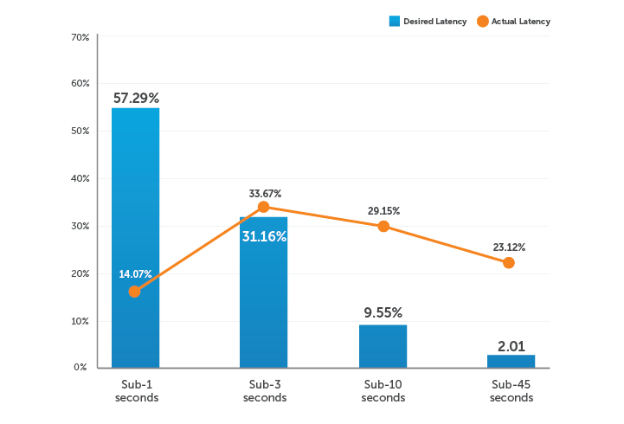
Video Streaming Latency Report: Desired Latency
Q: How much latency do you hope to achieve in the future?
Notes:
Panelist: Traci

Slide 6
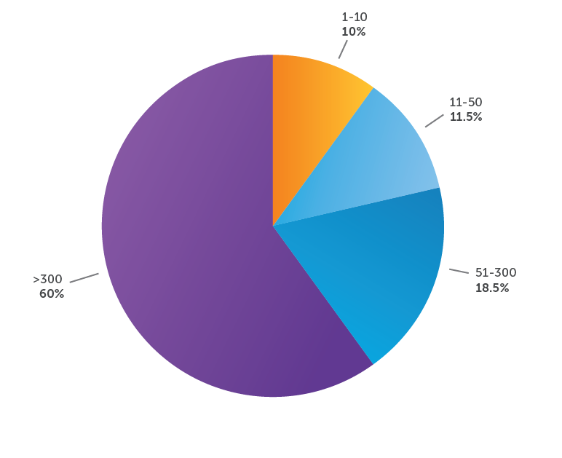
Video Streaming Latency Report: Scale
Q: What is your audience size?
Notes:
Panelist: Traci

Slide 7

Real-Time Streaming at Scale: Features and Benefits
Sub-500ms live interactive streaming
Delivery to a million viewers
On-demand availability
Encoder agnostic, with flexibility to broadcast produced content through an encoder or architect a browser-based solution.
Globally available
Can be combined with Wowza Professional Services for additional customization
Notes:
Panelist: Robert
Justin: <<Insert Poll Question>>
What is your biggest challenge you are experiencing with live video technology?
Controlling Cost/Bandwidth Usage
Achieving Real-Time Streaming (Low Latency)
Overall Stream Quality
DRM/Security
Other

Slide 8
Real-Time Streaming at Scale With Wowza
Notes:
Panelist Slide: Robert
JUSTIN:
<<INSERT QUESTION>>
“How does Wowza's offering compare other real-time streaming platforms leveraging WebRTC?”
“How do I implement a custom player?”
“Do I have to use obs?”

Slide 9

Using Real-Time Streaming at Scale
Simple REST Interface: | UI or API can be used for stream creation Only 5 endpoints: Create, Fetch One, Fetch All, Update Name, Delete Creating a stream is as simple as passing in a name; returns an ID and security tokens Details available at: https://api.docs.cloud.wowza.com/beta/tag/real_time
Javascript SDKs: | Wowza provides both broadcast and player Javascript SDKs for embedding in pages Real-Time Streaming at Scale packages include a Quick Start with Professional Services
Activating Real-Time Streaming: | Part of the Wowza Streaming Cloud platform Can be added to an existing account or created with a new account
Notes:
Panelist: Robert

Slide 10

Real-Time Streaming at Scale Demo
Notes:
Panelist:Tim/Barry to Demo

Slide 11
Use Case: Interactive Student Lecture Platform
Wowza Primary Benefits: | Live real-time interactivity Instant unlimited scalability
Product: | Real-Time Streaming at Scale with Wowza Streaming Cloud
Audience Size: | 500–1,000 Students
Outcomes: | Streaming interactive lectures to audiences of varying sizes, causing unpredictable scaling needs. Needed low-latency streaming, but achieving this became a struggle when broadcasts exceeded 300 viewers. Used Wowza’s Real-Time Streaming at Scale feature to offer interactive video with less than a second of latency, allowing students to chat and interact in real time — regardless of how many students are watching.
Notes:
Panelist Slide: Tim
“At DocTutorials, we live stream interactive lectures to audiences of varying sizes, causing unpredictable scaling needs. Low-latency streaming is critical to satisfy the back-and-forth nature of our workflow, but achieving this became a struggle when our broadcasts exceeded 300 viewers. Wowza’s Real-Time Streaming at Scale feature was the perfect solution. We’re now able to offer interactive video with less than a second of latency, allowing students to chat and interact in real time — regardless of whether 500 or 1,000 students are watching.”

Slide 12
Use Case: Event Technology Platform
Wowza Primary Benefits: | Near unlimited scale with real-time streaming​ Enable access to viewers on any device, in any location​ Ability to scale to 5,000+ streams per month
Product: | Real-Time Streaming at Scale with Wowza Streaming Cloud
Audience Size: | Thousands of broadcast streams​ Thousands of viewers per stream
Outcomes: | Wowza’s solution provided the capability to stream to a virtually unlimited number of viewers, whereas the previous platform imposed a 3,000 viewer limit.​ After thoroughly testing their POC, customer went live and has been so satisfied with the solution that they have already expanded use to include their sign language translation and multi-lingual services​. Already created over 10,000 streams as they transition their platform from previous provider to Wowza.
Notes:
Panelist Slide: Barry
Our mission is simple: create great software that inspires event planners to create amazing attendee experiences.​
​
EventsAIR is a secure, scalable, cloud-based solution that can manage everything from in-person, virtual to hybrid conferences, meetings and events in a single online platform – anywhere, anytime and on any device. In use in over 50 countries by multi-national corporations, professional conference organizers, government departments and tertiary education institutions, EventsAIR is also used in global congresses such as G20, APEC, CHOGM and ASEAN, as well as sporting events like The Olympic Games, World Rugby, Commonwealth Games and Pan Am Games. ​
​
EventsAIR has been at the forefront of Event Technology and Innovation for over 30 years, continually pushing the boundaries of what an event management platform can do. Built by event planners for event planners, EventsAIR is a secure, scalable, cloud-based solution that can manage everything from in-person, virtual to hybrid conferences, meetings and events in a single online platform – anywhere, anytime and on any device. In use in over 50 countries by multi-national corporations, professional conference organizers, government departments and tertiary education institutions, EventsAIR is also used in global congresses such as G20, APEC, CHOGM and ASEAN, as well as sporting events like The Olympic Games, World Rugby, Commonwealth Games and Pan Am Games. EventsAIR is trusted by event professionals around the globe​
​
EventsAIR core technology offers a range of tools that engage, enhance, and enable event planners to create successful events. In the new age of In-Person events, our technology has evolved with the times to include solutions that support Hybrid and Virtual—all still out one great, secure platform!

Slide 13
Q&A
Notes:
Justin to ask any remaining questions.

Slide 14

Download Now
2021 Video Streaming Latency Report
Visit wowza.com to learn more.
Notes:
Panelist: Traci
*Mention we will be sending everyone a copy in the follow-up email from the webinar today or they can go to wowza.com to download the report now right now.

Slide 15

Ready to Speak With a Streaming Professional?
Sales Support: sales@wowza.com
or call us toll free: 888.778.7997 | International: +1 720.222.4744
Pricing Plans: www.wowza.com/pricing
Technical Support: www.wowza.com/support
Notes:
Panelist: Traci

